Slide 1
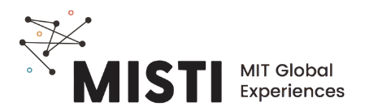
Introdução a polímeros

Slide 2

Onde os polímeros estão?
roupas
tênis
A bola
Notes:
Os polímeros estão presentes no nosso cotidiano. Vocês provavelmente ouviram falar de vários polímeros ou plásticos no contexto de uma partida de futebol. Quais são alguns exemplos ?

Slide 3
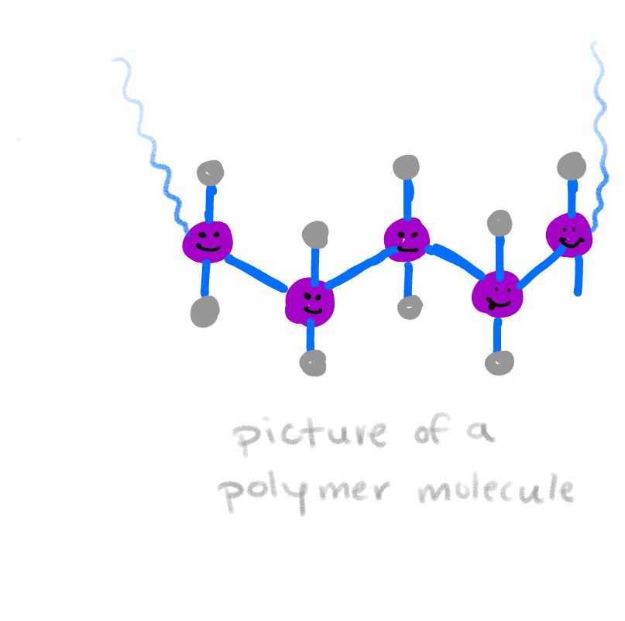
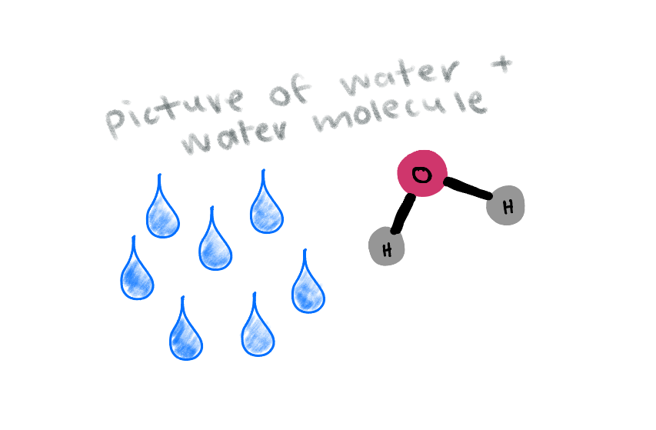
POLÍ - MERO
muitas
partes
água:
Uma molécula pequena
(3 átomos)
polymer:
a large molecule
(> 1,000 atoms)
Notes:
**Does the word break down like this in Portuguese? If not, adjust slide accordingly.** A palavra polímero tem etimologia grega e significa “muitas partes”. A maioria das moléculas que estudamos nas aulas de química são relativamente pequenas, entre 2 a 100 átomos, se a molécula for muito complexa. Polímeros são feitos de unidades que se repetem, os monômeros, quimicamente conectados para formar moléculas longas com 100 a até um milhão de monômeros.

Slide 4
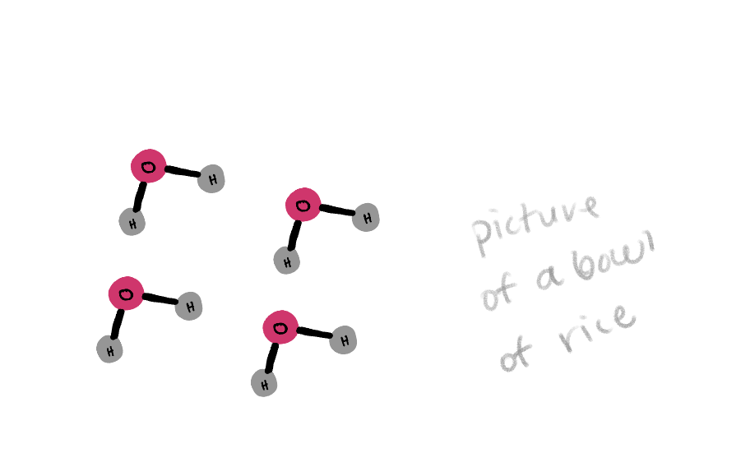
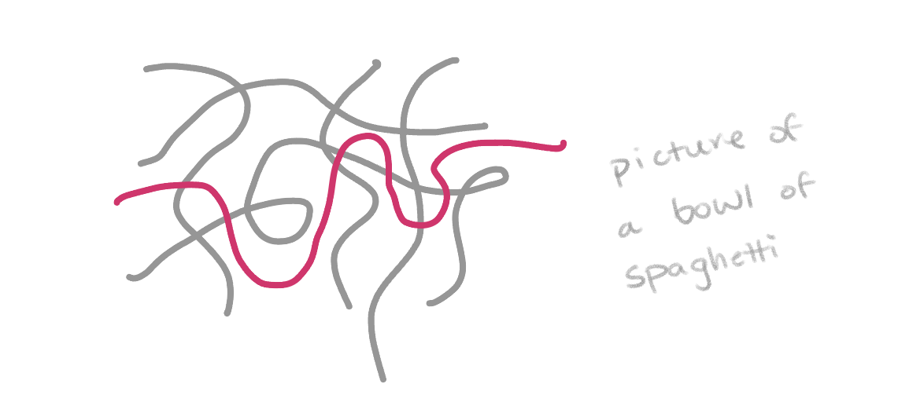
Polímeros são como espaguete
Notes:
Polymers have many unique properties as you just saw in the examples we were looking at. The main difference between polymers and other materials such as ceramics or metals is the length of the molecules. We can think of small molecules as rice- easy to mix, difficult to eat with, say, chopsticks since each grain is free to move around without the others. Polymers, on the other hand, are like spaghetti. If we connected a bunch of rice grains end to end, we’d eventually reach the length of a spaghetti noodle, much as monomers link together to form a polymer. Eating noodles with chopsticks is easy because they are entangled- it’s easy to grab a bunch at once, and extracting just one is actually quite challenging. This entanglement, and the corresponding friction between the long strands, is what give polymers many of their unique properties.

Slide 5
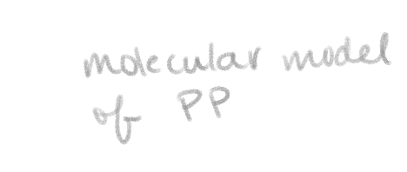
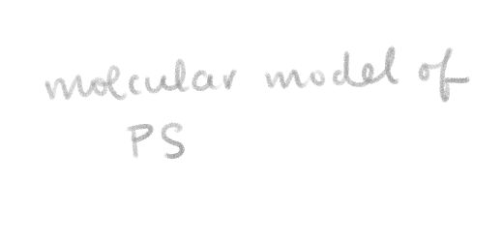
Nomenclatura e representação de polímeros
Várias representações possíveis
Fórmula molecular
Fórmula estrutural
Estrutura de traços
Nome
Modelo 3D
Polipropileno
(C₃H₆)_{n}
Poliestireno
(poli(1-fenileteno 1,2-diy))
(C₈H₈)_{n}
Notes:
There are many different ways to represent the same polymer, and it is useful to be able to translate between them. Common polymer often have a common name or trade name, as well as a technical name based on rules given by the international union of pure and applied chemistry. There a molecular formula, typically the repeating unit with a subscript n, which stands for the number of repeats. This can also be written as a structural or line formula, and modelled in space with various approximations; here a ball and stick model is shown. We’ll hand out a table with many of the polymers we’ll be discussing this week for reference.

Slide 6
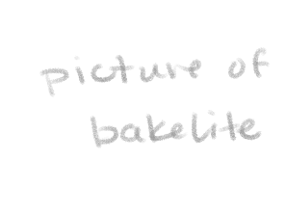
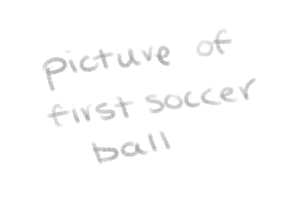
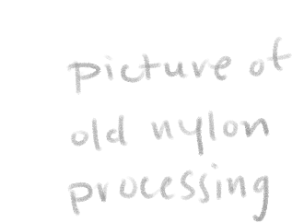
Uma breve história de polímeros
1500’s:
Maias fazem bolas da borracha da seringueira.
1839:
Goodyear descobre o processo de vulcanização.
1907:
O primeiro polímero sintético é feito
1976:
Polímeros viram o material mais produzido do mundo passando o aço
1855:
Goodyear cria a primeira bola de futebol de borracha.
1938:
Nylon é inventado
1941:
Polietileno, o polímero mais usado atualmente, é inventado.
Outros polímeros naturais (algodão, seda) eram usados muito antes
http://matse1.matse.illinois.edu/polymers/time.html
Notes:
Natural polymers have existed for as long as humans, and have been used as building materials, food, and clothing- in the 1500’s the Mayan records show playing with balls created form rubber trees. 300 years later, Charles Goodyear accidentally discovered that heating that rubber with sulfur additives cures it into a tough, long-lasting rubber, which he used to make the first rubber soccer ball a few years later. Previously balls were made of animal bladders or leather, which easily became water logged and leaked air. The first completely man-made polymer is created in 1907 and called Bakelite, which was used for everything from telephone casings to jewelry. Nylon is invented in 1938, with great impact to the fashion industry, closely followed by polyethylene, which would go on to become the most produced polymer in the world. By 1976, polymers are the most poduced material in the world.

Slide 7
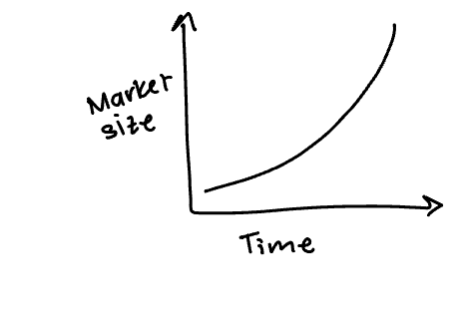
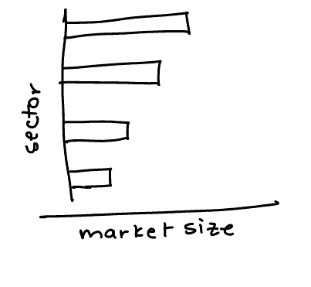
Polímeros hoje
Produção global
Produção por setor
Mercado de
$593
BILHÕES
(2021)
https://www.grandviewresearch.com/industry-analysis/global-plastics-market
Notes:
The global production of all types of plastitcs has grown exponentially since the 1950’s and 60’s, to a huge $593 billion today. Plastics are found across many different industries, with packaging being the largest by far, following by construction and textiles.

Slide 8
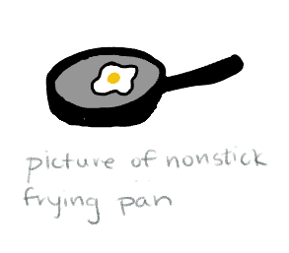
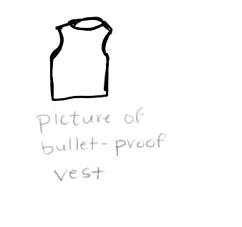
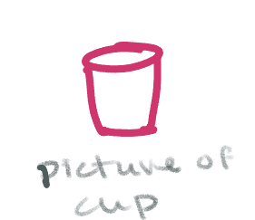
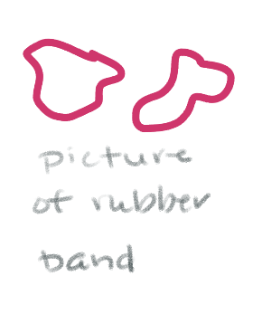
Polímeros podem ter muitas propriedades
Poliestireno
Rígido e quebradiço
Borracha
elástico
Teflon
escorregadio
Kevlar
Muito resistente
Notes:
There are so many different properties achieved through different chemistries and processing. The range from stiff and brittle polystyrene to tough and stretchy rubbery materials like polybutadiene. There are also highly specialized materials, such as teflon or Kevlar which have highly engineered properties. In this case, the fluorine atoms in teflon repel most other atoms, making non-stick pans slippery, while alignment and bonding between the chains in Kevlar create an incredibly strong and light material.

